Slide 1
On error and erasure correction coding for networks and deadlines
Tracey Ho
Caltech
NTU, November 2011

Slide 2
Network error correction problem
s2
t1
s1
t2
z unknown erroneous links
network
Problem of reliable communication under arbitrary errors on z links (or packets)
The set of erroneous links is fixed but unknown to the network user → cannot do error correction on individual links separately
Erasure correction is a related problem
2
Notes:
2

Slide 3
Background – network error correction
The network error correction problem was introduced by [Cai & Yeung 03]
Extensively studied in the single-source multicast case with uniform errors
  Equal capacity network links (or packets), any z of which may be erroneous
  Various capacity-achieving code constructions, e.g. [Cai & Yeung 03, Jaggi et al. 07, Zhang 08, Koetter & Kschischang 08]
Notes:
3

Slide 4

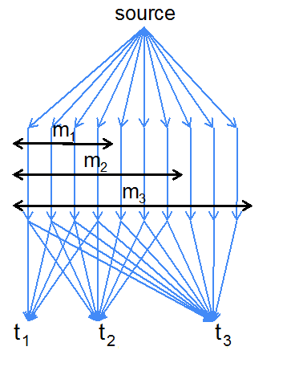
This talk : theory and applications of network error correction
Multi-source multicast network error correction
  Application to key pool bootstrapping
Network error/erasure correction as a model for analyzing reliable communication with deadlines
Combining information theoretic and cryptographic security against adversarial errors for computationally limited nodes
x
x
t₁
t₂
t₃
m₁
I₁
m₂
I₂
m₃
I₃
I₁
I₁, I₂
I₁, I₂, I₃
Notes:
4

Slide 5
This talk : theory and applications of network error correction
Multi-source multicast network error correction
  Application to key pool bootstrapping
Network error/erasure correction as a model for analyzing reliable communication with deadlines
Combining information theoretic and cryptographic security against adversarial errors for computationally limited nodes
Non-uniform network error correction
Notes:
5

Slide 6
Outline
  Multiple-source multicast, uniform errors
  Coding for deadlines: non-multicast nested networks
  Combining information theoretic and cryptographic security: single-source multicast
  Non-uniform errors: unequal link capacities
Notes:
6

Slide 7
Outline
  Multiple-source multicast, uniform errors
  T. Dikaliotis, T. Ho, S. Jaggi, S. Vyetrenko, H. Yao, M. Effros, J. Kliewer and E. Erez, IT Transactions 2011.
  Coding for deadlines: non-multicast nested networks
  Combining information theoretic and cryptographic security: single-source multicast
  Non-uniform errors: unequal link capacities
Notes:
7

Slide 8
Background – single-source multicast,
uniform z errors
Capacity = min cut – 2z, achievable with linear network codes (Cai & Yeung 03)
Capacity-achieving codes with polynomial-time decoding:
  Probabilistic construction (Jaggi, Langberg, Katti, Ho, Katabi & Medard 07)
  Lifted Gabidulin codes (Koetter & Kschischang 08, Silva, Kschischang & Koetter 08)
8
Notes:
8

Slide 9
Multiple-source multicast, uniform z errors
Source 1
Source 2
Sources with independent information
We could partition network capacity among different sources…
But could rate be improved by coding across different sources in the network? To what extent can different sources share network capacity?
Challenge: owing to the need for coding across sources in the network and independent encoding at sources, straightforward extensions of single-source codes are suboptimal
Related work: code construction in (Siavoshani, Fragouli & Diggavi 08) achieves capacity for C1+C2=C
Sink

Slide 10
Multiple-source multicast, uniform z errors
Source 1
Source 2
Sources with independent information
We could partition network capacity among different sources…
But could rate be improved by coding across different sources in the network? To what extent can different sources share network capacity?
Challenge: owing to the need for coding across sources in the network and independent encoding at sources, straightforward extensions of single-source codes are suboptimal
Related work: code construction in (Siavoshani, Fragouli & Diggavi 08) achieves capacity for C1+C2=C
Sink

Slide 11
Multiple-source multicast, uniform z errors
Source 1
Source 2
Sources with independent information
We could partition network capacity among different sources…
But could rate be improved by coding across different sources in the network? To what extent can different sources share network capacity?
Challenge: owing to the need for coding across sources in the network and independent encoding at sources, straightforward extensions of single-source codes are suboptimal
Related work: code construction in (Siavoshani, Fragouli & Diggavi 08) achieves capacity for C1+C2=C
Sink

Slide 12
Multiple-source multicast, uniform z errors
Source 1
Source 2
Sources with independent information
We could partition network capacity among different sources…
But could rate be improved by coding across different sources in the network? To what extent can different sources share network capacity?
Challenge: owing to the need for coding across sources in the network and independent encoding at sources, straightforward extensions of single-source codes are suboptimal
Related work: code construction in (Siavoshani, Fragouli & Diggavi 08) achieves capacity for C1+C2=C
Sink

Slide 13
Multiple-source multicast, uniform z errors
Source 1
Source 2
Sources with independent information
We could partition network capacity among different sources…
But could rate be improved by coding across different sources in the network? To what extent can different sources share network capacity?
Challenge: owing to the need for coding across sources in the network and independent encoding at sources, straightforward extensions of single-source codes are suboptimal
Related work: code construction in (Siavoshani, Fragouli & Diggavi 08) achieves capacity for C1+C2=C
Sink

Slide 14
Capacity region
U = set of source nodes
m_{S} = min cut capacity between sources in subset S of U and each sink
r_{i} = rate from the i^{th} source
Theorem: The capacity region (coherent & non-coherent) under any z link errors is given by the cut set bounds
Example: z = 1
  r₁ ≤ m₁ -2z =1
  r₂ ≤ m₂ -2z = 1
  (r₁ + r₂ ≤ m -2z = 2)
Source 1
Source 2
Sink

Slide 15
Capacity region
U = set of source nodes
m_{S} = min cut capacity between sources in subset S of U and each sink
r_{i} = rate from the i^{th} source
Theorem: The capacity region (coherent & non-coherent) under any z link errors is given by the cut set bounds
Example: z = 1
  r₁ ≤ m₁ -2z =1
  r₂ ≤ m₂ -2z = 1
  (r₁ + r₂ ≤ m -2z = 2)
Source 1
Source 2
Redundant capacity is completely shared!
Sink

Slide 16
Achievable constructions
Probabilistic construction, joint decoding of multiple sources
  Requires a different distance metric for decoding than single source multicast decoding metric from Koetter & Kschischang 08
Gabidulin codes in nested finite fields, successive decoding

Slide 17
Background - Gabidulin codes
n
1
M =
M =
r
r

Slide 18
Background - Gabidulin codes
r
n
1
1
*
M =
=
GM=
GM =
r
r+t
r+t
Channel
GM
GM +E
Transmit [I x], where x is a codeword of a Gabidulin code
Achieves capacity C – 2z for single-source multicast with efficient decoding algorithms (Koetter & Kschischang 08, Silva, Kschischang & Koetter 08)

Slide 19
Nested Gabidulin codes for multiple source multicast
Interior nodes do random linear network coding in GF(q)
Sources encode with Gabidulin codes over nested extension fields GF(q ), GF(q ),…, GF(q ) where n_{i} ≥ r_{i} +2z
Enables successive decoding at the sinks, starting from outermost source k
n₁
n₁n₂
n₁n₂…n_{k.}

Slide 20
Nested Gabidulin codes - 2 sources
Y=T₁G₁M₁+T₂G₂M₂+E
(1)
G
(2)
₁
G
₂
D
G
invertible whp for RLNC
₁
(D⁻¹Y) =
D⁻¹E
G
₂
lowest r₂+2z
rows
(D⁻¹Y)
G
(D⁻¹E)
(3)
₂
Matrix of rank z over F_{q}
Matrix of rank z over F_{q}
n₁

Slide 21
An application: key pool bootstrapping
A key center generates a set of keys {K1, K2, … }, a subset of which needs to be communicated to each network node
Instead of every node communicating directly with the key center, nodes can obtain keys from neighbors who have the appropriate keys
Use coding to correct errors from corrupted nodes

Slide 22
Key pool bootstrapping
Problem is equivalent to multi-source network error correction
Coding across keys is needed for optimal error resilience
V1
V2
V3
V4
V5
V6
V7
V8
V9
k1, k2
k1, k2
k1, k2
k1, k3
k1, k3
k1, k3
k2, k3
k2, k3
k2, k3
R
S1
S2
S3
V1
V2
V3
V4
V5
V6
V7
V8
V9
R

Slide 23
Outline
  Multiple-source multicast, uniform errors
  Coding for deadlines: non-multicast nested networks
  O. Tekin, S. Vyetrenko, T. Ho and H. Yao, Allerton 2011.
  Combining information theoretic and cryptographic security: single-source multicast
  Non-uniform errors: unequal link capacities
Notes:
23

Slide 24
Background - non-multicast
Finding the capacity region of a general non-multicast network even in the erasure-free case is an open problem
  Coding across different sinks’ packets (inter-session coding) is sometimes required
  We don’t know in general when intra-session coding is sufficient
We can derive cut set bounds by analyzing three-layer networks (Vyetrenko, Ho & Dikaliotis 10)

Slide 25
Motivation
x
x
Packet erasures/errors
Initial play-out delay
m₁
I₁
m₃
I₃
m₂
I₂
Decoding deadlines
Demanded information

Slide 26
Three-layer nested networks
A model for temporal demands
  Links ↔ Packets
  Sinks ↔ Deadlines by which certain information must be decoded
Each sink receives a subset of the information received by the next (nested structure)
Packet erasures can occur
Non-multicast problem
t₁
t₂
t₃
I₁
I₁, I₂
I₁, I₂, I₃
Notes:
Number of links will depend on the data transfer speed.

Slide 27
Erasure models
We consider two erasure models:
z erasures (uniform model)
  At most z links can be erased, locations are unknown a priori.
Sliding window erasure model

Slide 28
z erasures – upper bounding capacity
Want to find the capacity region of achievable rates u₁,u₂,…,u_{n}
We can write a cut-set bound for each sink and erasure pattern (choice of z erased links)
  u₁ ≤ m₁ ̶ z
  u₁+u₂ ≤ m₂ ̶ z
  …
  u₁+u₂+…+u_{n} ≤ m_{n} ̶ z
Can we combine bounds for multiple erasure patterns and sinks to obtain tighter bounds?
t₁
t₂
t₃
I₁
I₁, I₂
I₁, I₂, I₃

Slide 29
Cut-set combining procedure
Example: m₁=3,m₂=5, m₃=7, m₄=11, z=1
u₁+H(X₁X₂|I₁) ≤2
u₁+H(X₁X₃|I₁) ≤2
u₁+H(X₂X₃|I₁) ≤2
12
1245
124567
Iteratively apply steps:
Extend: H(X |I₁^{i-1})+ |Y| ≥ H(X,Y |I₁^{i-1})= H(X,Y |I₁^{i})+ u_{i}
where X,Y is a decoding set for I_{i}
Combine:
13
1345
134567
1234567
23
2345
234567
1234
123467
1234567
1235
123567
123456
1234567
123457
123456
1234567
123457
1234567

Slide 30
Upper bound derivation graph
Example: m₁=3,m₂=5, m₃=7, m₄=11, z=1
Capacity region:
12
1245
124567
u₁≤2
3u₁+2u₂ ≤8
3u₁+2u₂+u₃ ≤9
6u₁+5u₂+4u₃ ≤24
6u₁+4u₂+2u₃+u₄≤20
9u₁+6u₂+4u₃+3u₄ ≤36
6u₁+5u₂+4u₃+2u₄ ≤28
6u₁+4.5u₂+4u₃+3u₄ ≤30
9u₁+7.5u₂+7u₃+6u₄ ≤54
13
1345
134567
1234567
23
2345
234567
1234
123467
1234567
1235
123567
123456
1234567
123457
123456
1234567
123457
1234567
Different choices of links at each step give different upper bounds
Exponentially large number of bounds
Only some are tight – how to find them?
We use an achievable scheme as a guide and show a matching upper bound

Slide 31
Intra-session Coding
y_{j,k} : capacity on k^{th} link allocated to j^{th} message
We may assume y_{j,k} = 0 for k>m_{j}
P : set of unerased links with at most z erasures
A rate vector (u₁,u₂,…,u_{n}) is achieved if and only if:
 | 1 | 2 | … | m_{n} | Σ_{P}
I₁ | y_{1,1} | y_{1,2} | … | y_{1,m_n} | ≥ u₁
I₂ | y_{2,1} | y_{2,2} | … | y_{2,m_n} | ≥ u₂
… | … | … | … | …
I_{n} | y_{n,1} | y_{n,1} | … | y_{n,m_n} | ≥ u_{n}
Σ | ≤1 | ≤1 |  | ≤1

Slide 32
“As uniform as possible” intra-session coding scheme
Fill up each row as uniformly as possible subject to constraints from previous rows
Example:
m₁ = 10, m₂ = 14, m₃ = 18, m₄ = 22,
u₁ = 6, u₂ = 3, u₃ = 3, u₄ = 4, z=2
 | 1,2,…,9,10 | 11,12,13,14 | 15,16,17,18 | 19,20,21,22
I₁
I₂
I₃
I₄
0.75
0.25
0.25
0
0.5
0.5
0.1875
0.1875
0.1875
0.2
0
0
0.4
0.2
0.25
0.4
0.2
0.5
0.4
0.2
0.5
Can we do better?

Slide 33
Capacity region
Theorem: The z-erasure (or error) correction capacity region of a 3-layer nested network is achieved by the “as uniform as possible” coding scheme.

Slide 34
Proof Idea
Consider any given rate vector (u₁,u₂,…,u_{n}) and its corresponding “as uniform as possible” allocation:
Obtain matching information theoretic bounds, by using T_{i,j} values to choose path through upper bound derivation graph
 | 1,2,…,m₁ | m₁ +1,…,m₂ | m₂ +1,…,m₃ | … | m_{n-1} +1,…,m_{n}
I₁ | T_{1,1}
I₂ | T_{2,1} | T_{2,2}
I₃ | T_{3,1} | T_{3,2} | T_{3,3}
… | … | … | … | …
I_{n} | T_{n,1} | T_{n,2} | T_{n,3} | … | T_{n,n}

Slide 35
Proof Idea
m_{n}
m_{k}
m₂
m₁
W₁
W₂
…
W_{k}
Consider any unerased set with at most z erasures.
  Show by induction: The conditional entropy of W given messages I₁,…, I_{k} matches the residual capacity in the table, i.e.

Slide 36
Proof Idea
For any set with |V|= m_{k}-z, an upper bound for H(V| I₁^{k}) can be derived as follows:
  let V’ be the subset of V consisting of links upstream of t_{k-1}
  obtain H(V’| I₁^{k-1}) from the table (induction hypothesis)
  extend : H(V |I₁^{k}) ≤ H(V’|I₁^{k-1})+ |V \V’| − u_{k}
For each row k, there exists a column k* such that all T_{i,j} are all equal for j>k*
    Combine over all such having erasures on links m_{k*+1},m_{k*+2},…, m_{k} to obtain:

Slide 37
z-error capacity region
A linear non-multicast code that can correct 2z erasures can correct z errors [Vyetrenko, Ho, Effros, Kliewer & Erez 09]
An arbitrary code for a three-layer network that can correct z errors can correct 2z erasures (Singleton-type argument)
Since our capacity-achieving code is linear, the z-error capacity region is the same as the 2z-erasure capacity region

Slide 38
Sliding window erasure model
Parameterized by erasure rate p and burst parameter T.
For y≥T, at most py out of y consecutive packets can be erased.
Erasures occur with rate p in long term.
Erasure bursts cannot be too long (controlled by T ).

Slide 39
Sliding window erasure achievable region
Theorem: Let the rate vector be achievable. Then the rate vector
is achieved by “as uniform as possible” coding.
Note: asymptotically optimal for m₁ >> T >>1

Slide 40
Outline
  Multiple-source multicast, uniform errors
  Coding for deadlines: non-multicast nested networks
  Combining information theoretic and cryptographic security: single-source multicast
  S. Vyetrenko, A. Khosla & T. Ho, Asilomar 2009.
  Non-uniform errors: unequal link capacities
Notes:
40

Slide 41
Problem statement
Single source, multicast network
Packets may be corrupted by adversarial errors
Computationally limited network nodes (e.g. low-power wireless/sensor networks)

Slide 42
Background: information-theoretic and cryptographic approaches
Information theoretic network error correction
  Existing codes are designed for a given upper bound z_{U} on the number of errors, achieve rate mincut -2z_{U}, e.g. [Yeung and Cai 03]
Cryptographic signatures with erasure correction
  Cryptographic signatures allow network coded packets to be validated, e.g. [Zhao et al. 07, Boneh et al. 09]
  If all packets are signed and each network node checks all packets, then rate mincut - z can be achieved, where z is the actual number of erroneous packets

Slide 43
Motivation for hybrid schemes
Performing signature checks at network nodes requires significant computation
Checking all packets at all nodes can limit throughput when network nodes are computationally weak
Want to use both path diversity as well as cryptographic computation as resources, to achieve rates higher than with each separately

Slide 44
Approach
Cannot afford to check all packets use probabilistic signature checking
Deterministic bound on number of erroneous packets is needed in existing network error correction code constructions
Rather than have to choose a conservative bound, we want a code construction that does not require an upper bound on the number of errors to be known in advance

Slide 45
Fountain-like network error correction code
We propose a fountain-like error-correcting code which incrementally sends redundancy until decoding succeeds (verified by signature checks)
Each adversarial error packet can correspond to an addition (of erroneous information) and/or an erasure (of good information)
Construction:
Message
For additions
Linearly independent redundancy
Linearly dependent redundancy
For erasures
Linearly independent redundancy
Linearly dependent redundancy

Slide 46
Example: simple hybrid strategy on wireless butterfly network
Node D has limited computation and outgoing capacity
→ Carries out probabilistic signature checking/coding
Proportion of packets checked/coded chosen to maximize expected information rate subject to computational budget

Slide 47
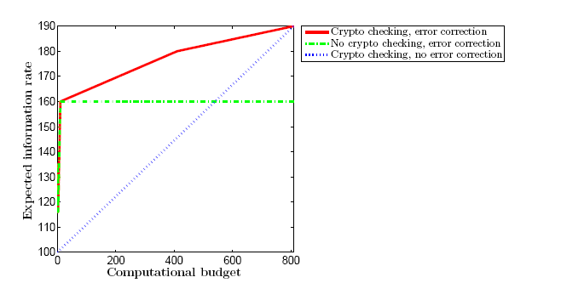
Example: simple hybrid strategy on wireless butterfly network

Slide 48
Outline
  Multiple-source multicast, uniform errors
  Coding for deadlines: non-multicast nested networks
  Combining information theoretic and cryptographic security: single-source multicast
  Non-uniform errors: unequal link capacities
S. Kim, T. Ho, M. Effros and S. Avestimehr, IT Transactions 2011.
  T. Ho, S. Kim, Y. Yang, M. Effros and A. S. Avestimehr, ITA 2011.
Notes:
48

Slide 49
Uniform and non-uniform errors
Uniform errors:
  Multicast error correction capacity = min cut – 2z
  Worst-case errors occur on the min cut
Non-uniform errors:
  Model: network with unequal link capacities, adversarial errors on any z fixed but unknown links
  Not obvious what are worst-case errors
    Cut size versus link capacities
    Feedback across cuts matters
  Related work: Adversarial nodes (Kosut, Tong & Tse 09)

Slide 50
Network cuts
Only forward link capacities matter in the equal link capacity case
S
Both forward and feedback links matter in the unequal link capacity case
Feedback can provide information about errors on upstream links
U
50
Notes:
50

Slide 51
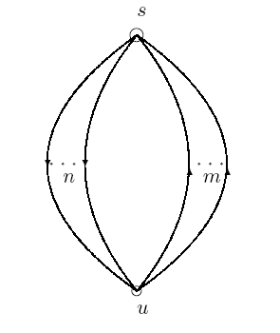
Two-node cut set bounding approach
S
Two-node network with n forward links and m feedback links
U
51
Notes:
51

Slide 52
Tighter cut set bounding approach
The two-node cut set bounding approach is equivalent to adding reliable, infinite-capacity bidirectional links between each pair of nodes on each side of the cut
Tighter bounds can be obtained by taking into account which forward links affect or are affected by which feedback links
Equivalent to adding a link (i,j) only if there is a directed path from node i to node j on that does not cross the cut
Zigzag network
52
Notes:
52

Slide 53
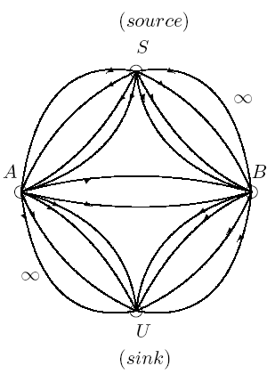
Downstream condition
A set of links K on a cut Q is said to satisfy the downstream condition if none of the remaining links on the cut Q are downstream of any link in K.
K
K

Slide 54
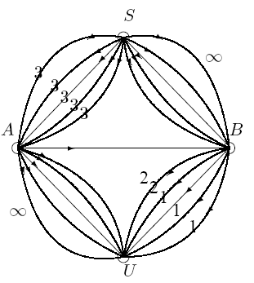
Generalized Singleton bound
Generalized Singleton bound [Kim, Ho, Effros & Avestimehr 09, Kosut, Tong & Tse 09]:
For any cut Q, after erasing any 2z links satisfying the downstream condition, the total capacity of the remaining links in Q is an upper bound on error correction capacity.
When z=3, generalized Singleton bound is 3+3+3+3=12

Slide 55
Generalized Singleton bound - intuition
Suppose the bound is violated. Then there exist two codewords x, x’ that differ in 2z links satisfying the downstream condition and agree on the remaining links
There exist error values e, e’ such that sink U cannot distinguish (x,e) and (x’,e’)
a
b'
c'
d'
a
a
a
b
b'
b'
c
c'
c'
d
d''
d"

Slide 56
Idea 1
Observation: generalized Singleton bound is not tight when downstream links have smaller capacities.
Idea 1: erase any k≤z largest capacity links and apply Singleton bound with z-k adversarial links on remaining network.

Slide 57
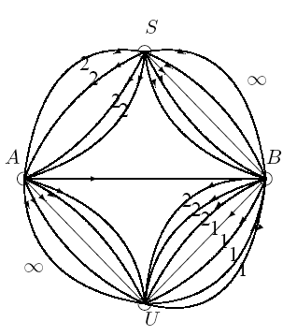
Idea 2
If adversary controls some forward links as well as their downstream feedback links, he can hide his errors
y₁
y₁
y₂
y₂
’
u₁’
u₁
u₂
u₂’
’
’
’
y₁,y₂,u₁,u₂
y₁,y₂, u₁’, u₂’
w₁
’
w₃
w₁
y₃
’
y₃
w₃
y₆
y₆
y₆

Slide 58
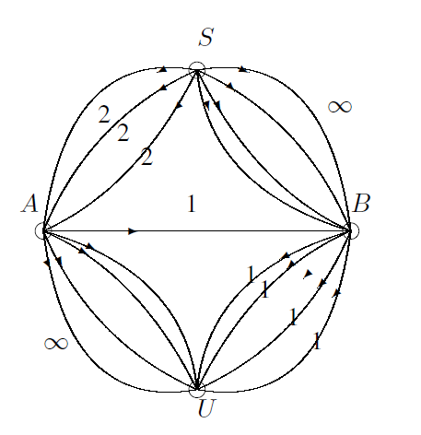
Idea 3
Observation: For small feedback link capacities, distinct codewords have the same feedback link values
Idea 3: adversary can cause confusion between codewords that agree on the feedback links
’
y₁’
y₁
’
y₂
y₂’
y₃
y₃
1
1
u
u
y₄
y₄
y₅
y₅
y₆
y₆'
y₇
y₇'

Slide 59
New cut-set bound
For any cut Q,
adversary first erases a set of k ≤ z forward links (idea 1)
adversary then chooses two sets Z₁ ,Z₂ of z-k links such that any feedback link directly downstream of links in both Z₁ and Z₂ and upstream of a forward link in Q\Z₁\Z₂ is included in both Z₁ and Z₂ (idea 2)
  let W_{i} be the set of feedback links not in Z_{i} (idea 2) that are directly downstream of a link in Z_{i} and upstream of a forward link in Q\Z₁\Z₂ (idea 3)
sum of capacities of remaining forward links + capacities of links in W₁ ,W₂ is an upper bound
Bound is tight on some families of zig-zag networks

Slide 60
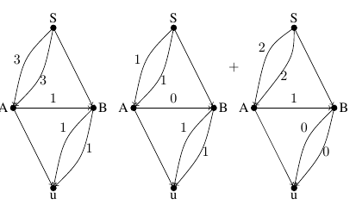
Achievability - example
For z=1, upper bound = 5
Without feedback link, capacity = 2
Can we use feedback link to achieve rate 5?
z=1
Achieve rate 3 using new code construction

Slide 61
“Detect and forward” coding strategy
a
+f
Some network capacity is allocated to redundancy enabling partial error detection at intermediate nodes
Nodes that detect errors forward additional information allowing the sink to locate errors
Use feedback capacity to increase the number of symbols transmitted with error detection
Remaining network capacity carries generic linear combinations of information symbols, serving as an MDS error correction code
b
a
b
∞
y₁
y₂
f
∞
y₃
z=1
Achieve rate 3 using new code construction
y₄
z=1
capacity= 5

Slide 62
Conclusion
Network error correction as a model for analyzing and designing codes for robust streaming
Coding for adversaries: Information theoretic and hybrid cryptographic approaches
New codes and outer bounds for more general networks and communication demands

Slide 63
Thank you!

Slide 64
Coherent & non-coherent models
Coherent: network topology known, centralized code design
Non-coherent (multicast): network topology unknown, use distributed random linear network coding (RLNC)
    each packet comprises a vector of symbols from a finite field F_{q}
    each node sends linear combinations of its received packets with coefficients chosen uniformly at random from F_{q}
    record network transformation in packet headers, or encode information in subspaces
(a₁,…, a_{n})
(b₁,…, b_{n})
(γa₁ +λb₁,…,γa_{n}+λb_{n})

Slide 65
Coding and decoding
Coding over blocks (generations) of source packets
Phase : transmit source packets
Phase : transmit linearly independent redundant packets and linearly dependent redundant packets
At each phase the sink tries to decode (using a polynomial-time decoding algorithm similar to [Jaggi et al., 2007]), and performs signature checks on the decoded packets
If the decoded packets pass the signature checks, the sink sends feedback telling the source to move on to the next block
Linearly independent redundancy
Linearly dependent redundancy
Linearly independent redundancy
Linearly dependent redundancy

Slide 66
Field Extensions: example

Slide 67
Field Extensions
F_{q}
n₁n₂
F_{q}
n₁
F_{q}

Slide 68


Encoding
r₁
n
G₁ can correct rank z errors over F_{q}
n
G₁
X₁
M₁
r₁+2z
r₁+2z
x
=
r₂
n
G₂ can correct rank z errors over F_{q}
n
G₂
X₂
M₂
r₂+2z
r₂+2z
x
=
n₁
n = kn₁n₂ where n_{i}≥r_{i} +2z

Slide 69
Decoding
Matrix of rank z over F_{q}
(D⁻¹Y) = G₂M₂+(D⁻¹E)
Matrix of rank z over F_{q}
n₁
(This is why we need the extension field)
M₂ can be decoded (same as single-source decoding problem)
Decoder then subtracts effect of M₂ and decodes M₁

Slide 70
Idea 1 - example
Four-node network with z=2 .
Singleton bound is 3 x 5 +1 = 16.
a) First erase one link with largest capacity.
b) Apply Singleton bound on remaining network for z=1.
New bound is
3+3+3+3+1+1+1=15 <16

